Slide 1
Project Recap Presentation
memreprise
Casey Nguyen, Brent Johnson, Tristan Wang, Gray Wong

Slide 2

memreprise
where music and memories meet
Notes:
Project name and value proposition

Slide 3

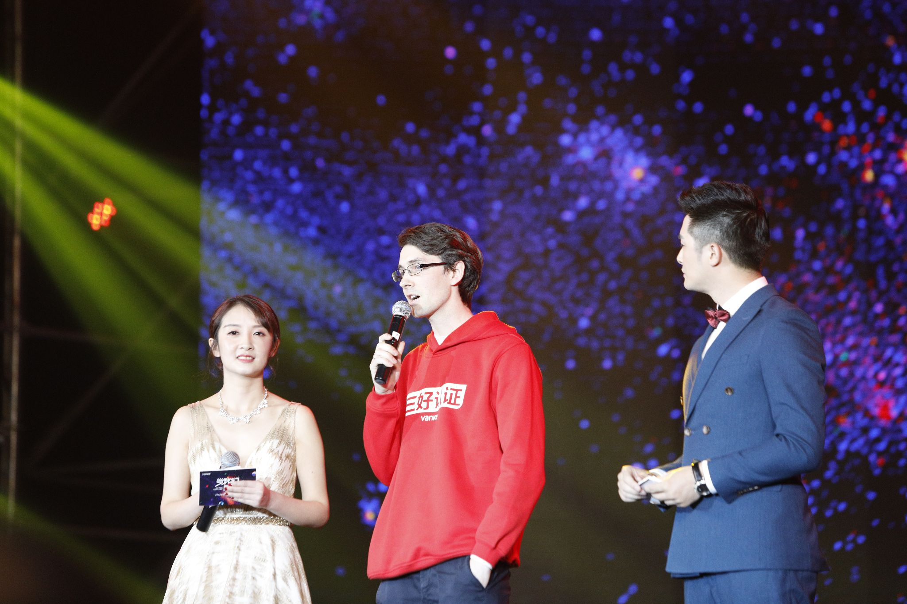
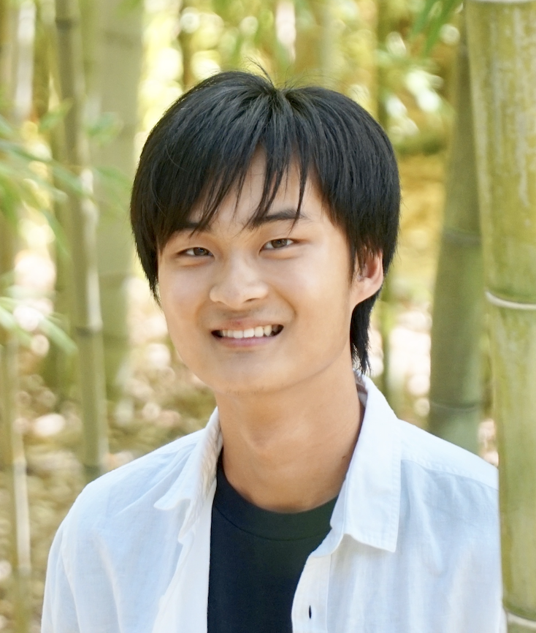
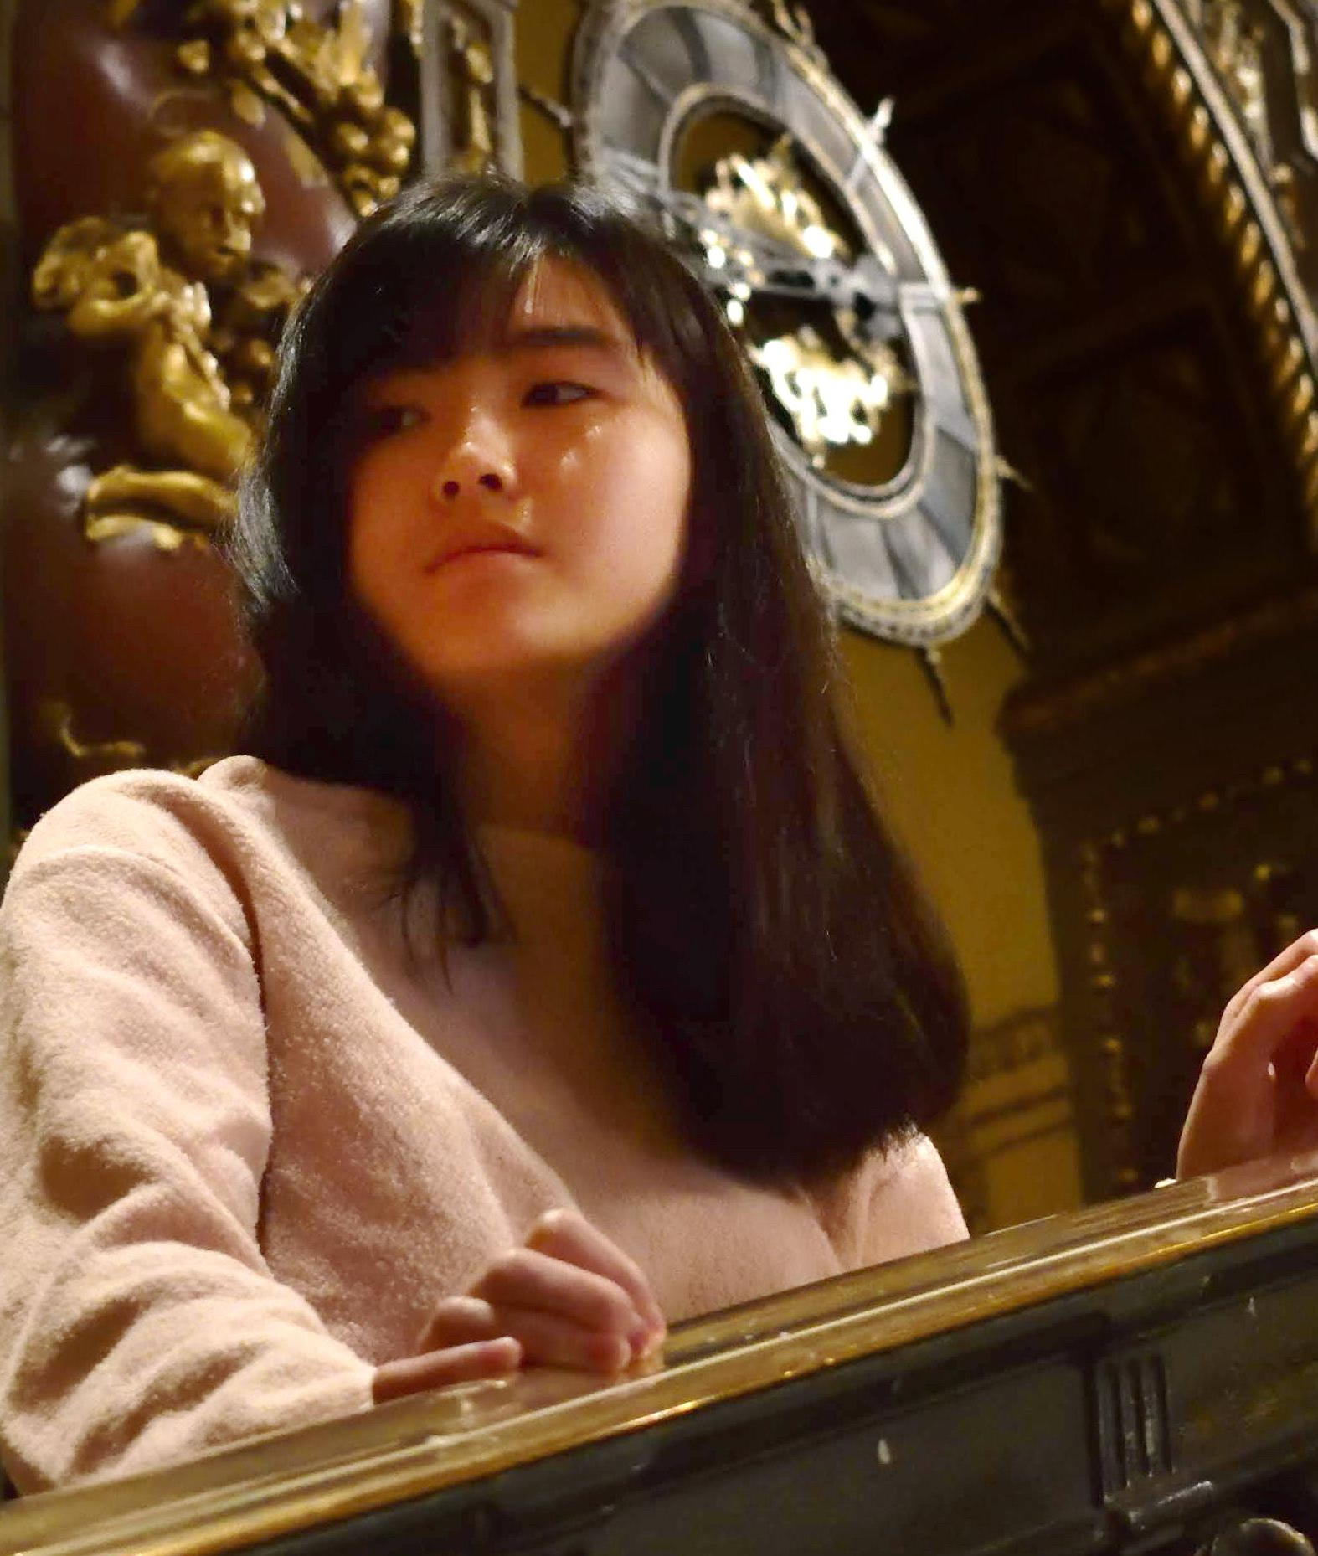
Team Members
Casey Nguyen
BSCS ‘24, MSCS ‘24
Full Stack Developer
Brent Johnson
MSLDT ‘24
Designer, Developer, Author, PM, Educator
Tristan Wang
MSCS ‘24
Designer, Developer
Gray Wong
MSCS ‘24
Designer, Developer
Notes:
Team member names & roles

Slide 4
Problem & Solution Overview
Problem
Solution
People often have deep, yet hard-to-quantify associations with their favorite music.
These associations go undocumented and unshared
An app that prompts you daily to:
Log the song you’re currently listening to
Associate it with a
themed question
Discover new music by seeing how other users answered and tagged their music
Notes:
Problem/solution overview

Slide 5
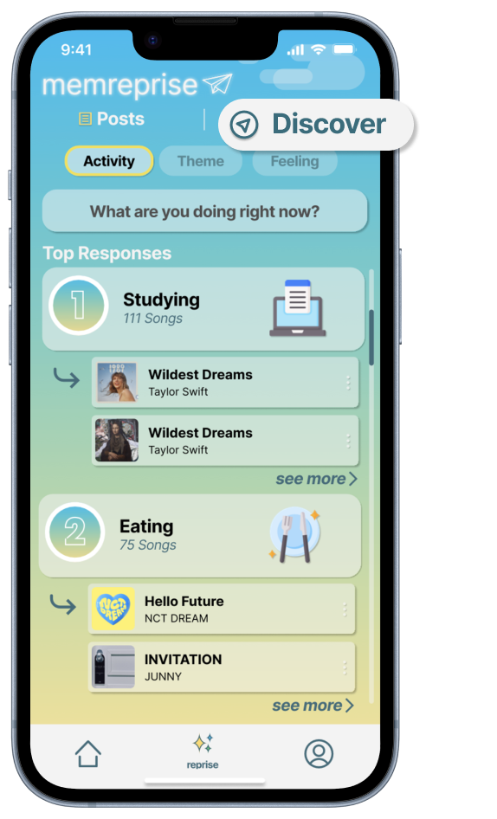
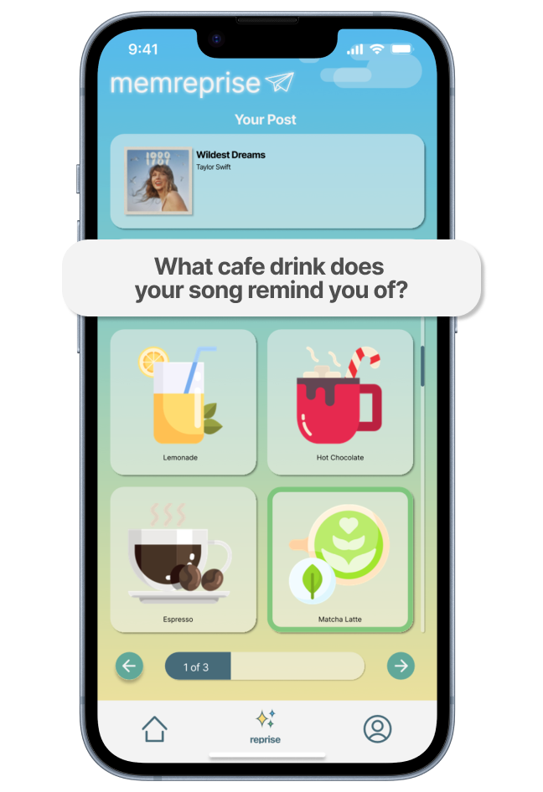
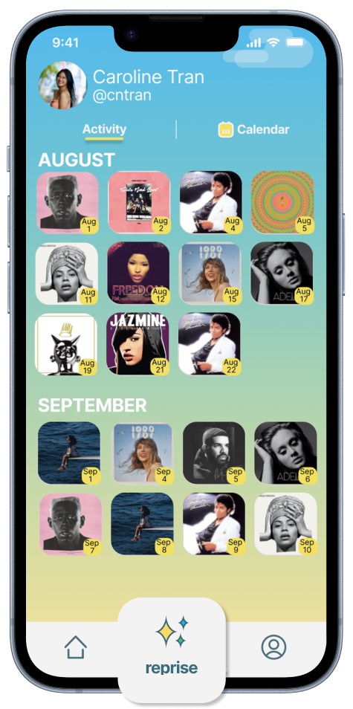
Who does it serve?
Those interested in new music
Those interested in random music exchange
Those willing to share their own music
Those who like documenting their lives
Notes:
Before and after shots + rationale

Slide 6
Presentation Outline
01
02
03
04
Design Evolution
(slides 7 - 19)
Current UI
(slides 20 - 31)
Demo
(slides 32 - 33)
Future Enhancements
(slides 34 - 40)
Notes:
Talk Outline

Slide 7
01
Design Evolution

Slide 8

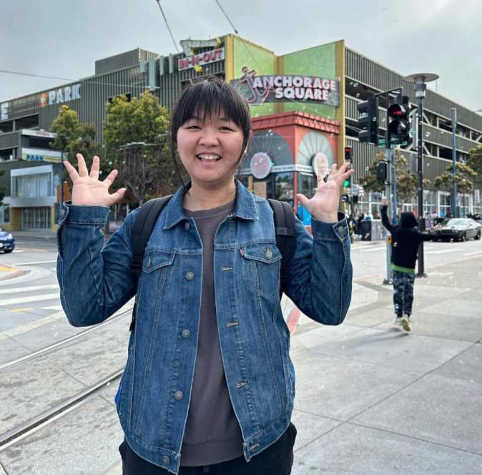


Needfinding
How can we harness power of music to evoke emotions and connect with past?
Lasting and renewable connection between music and cultural roots
Musical impact also relies on the environment and physical medium
Blend of musical interests are positively accepted from our interviewees
Strong emotional connections to varied music over many years.
Music has the power to transport listeners.
Notes:
Summary of the results

Slide 9
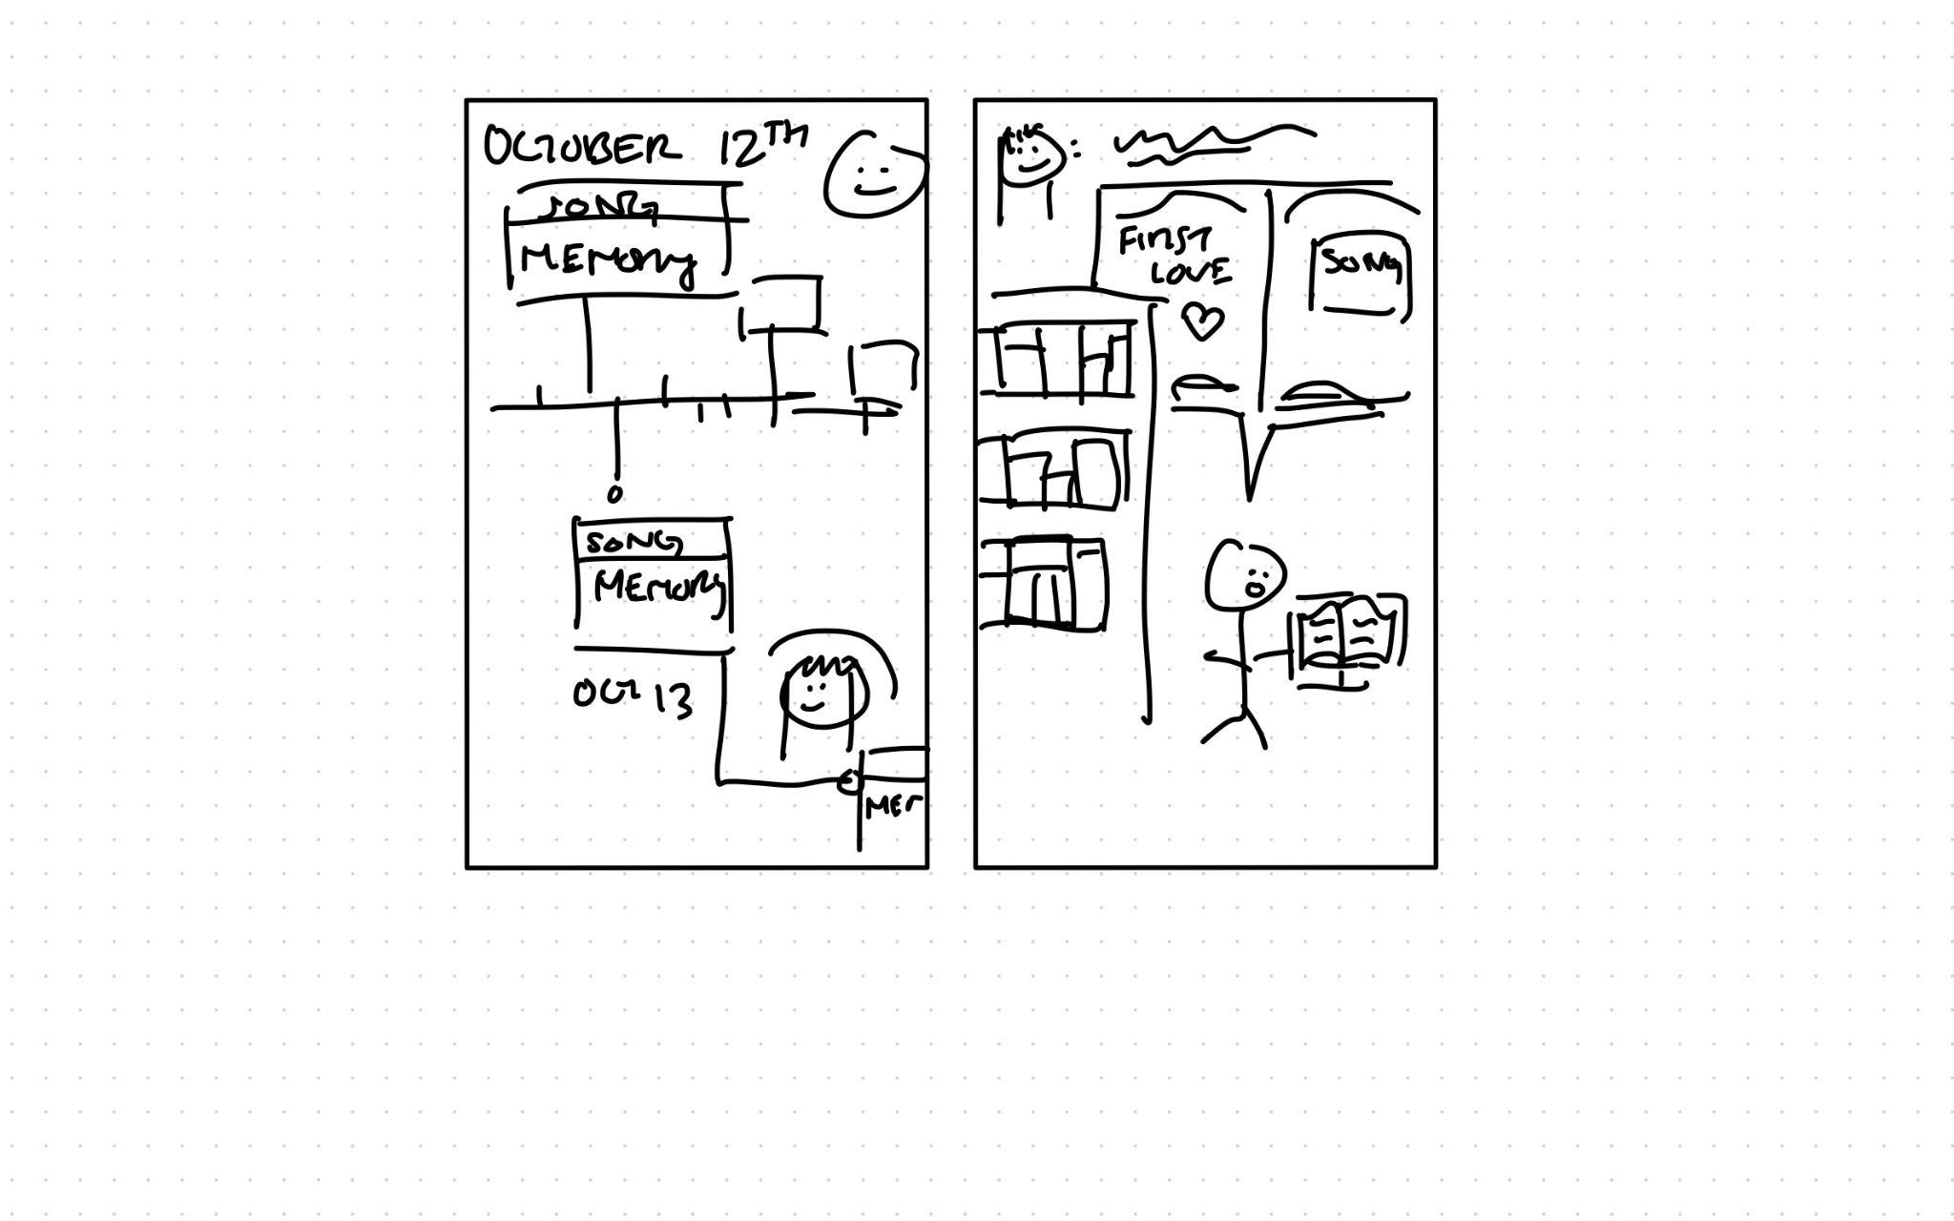
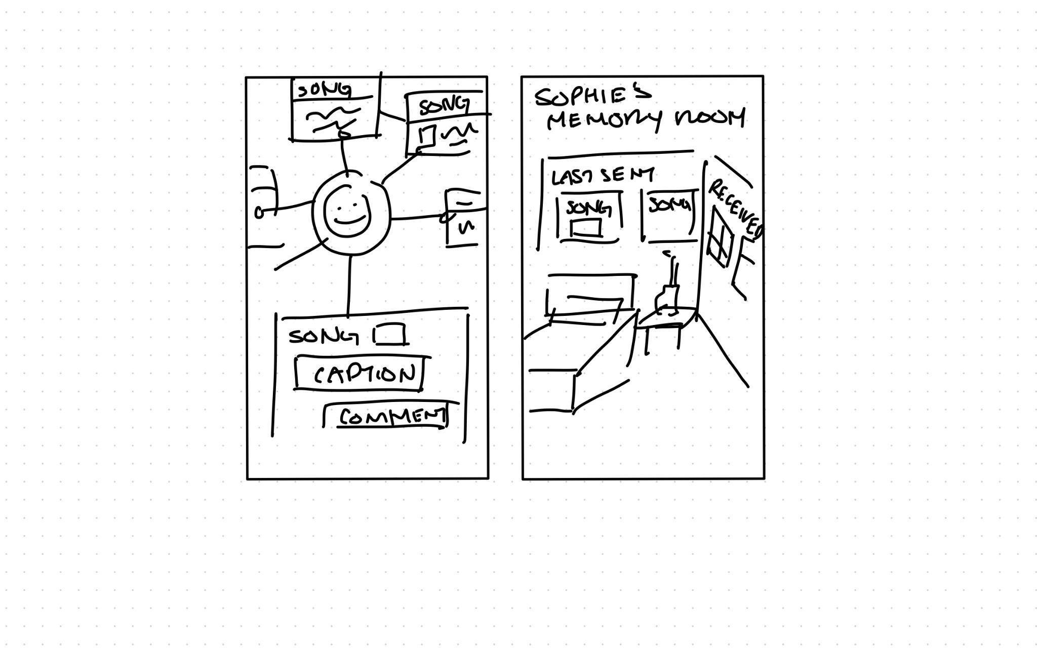
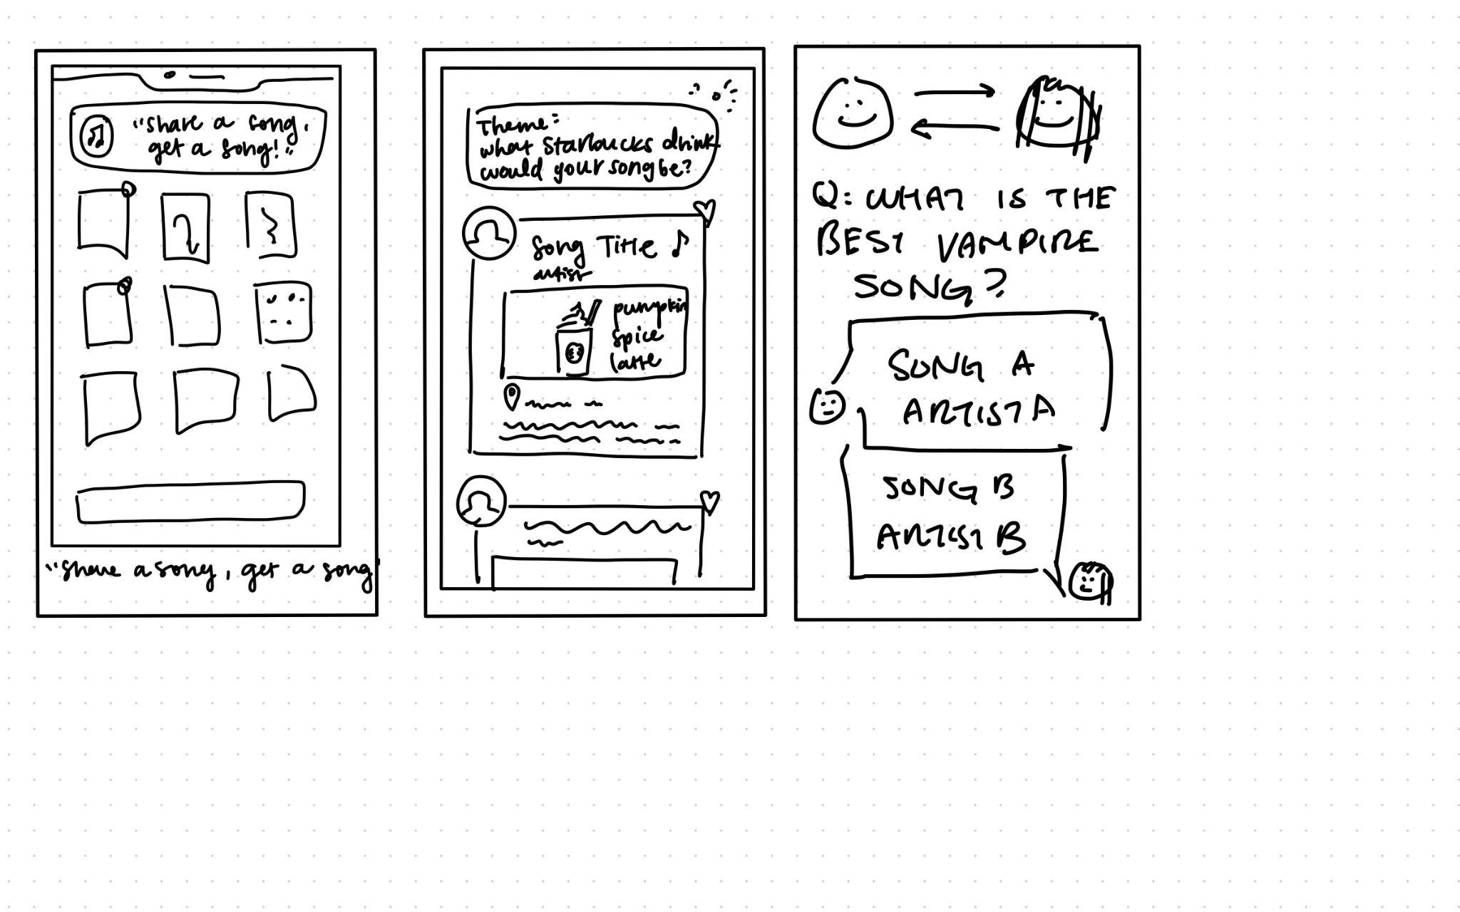
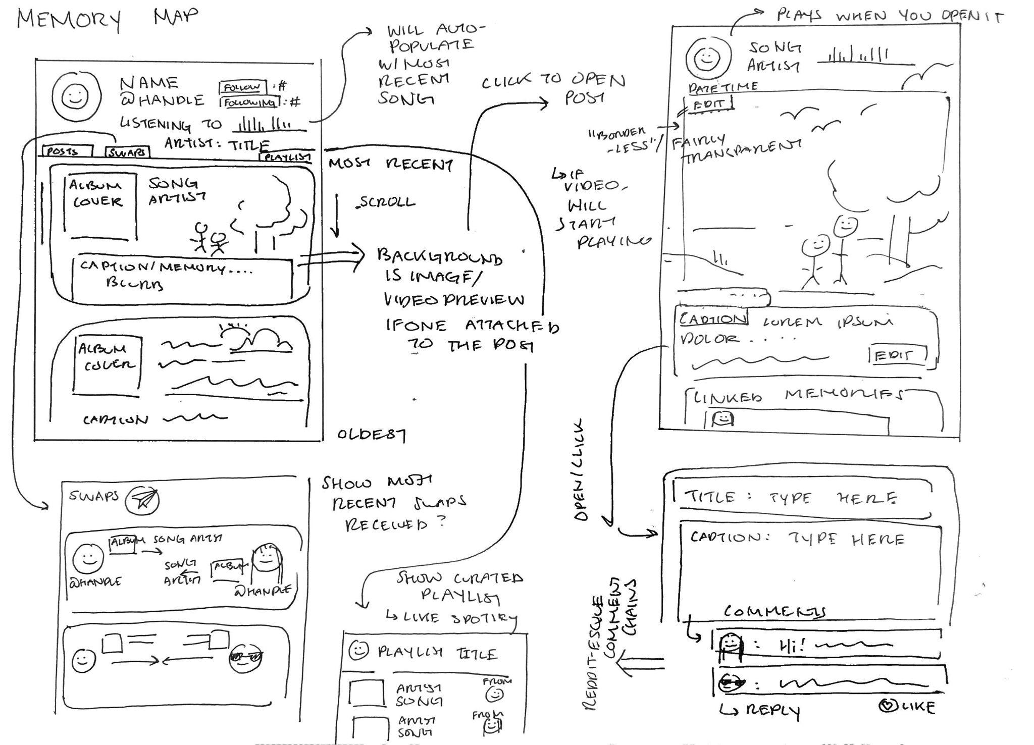
Concept Sketches
Notes:
Summary of the results

Slide 10
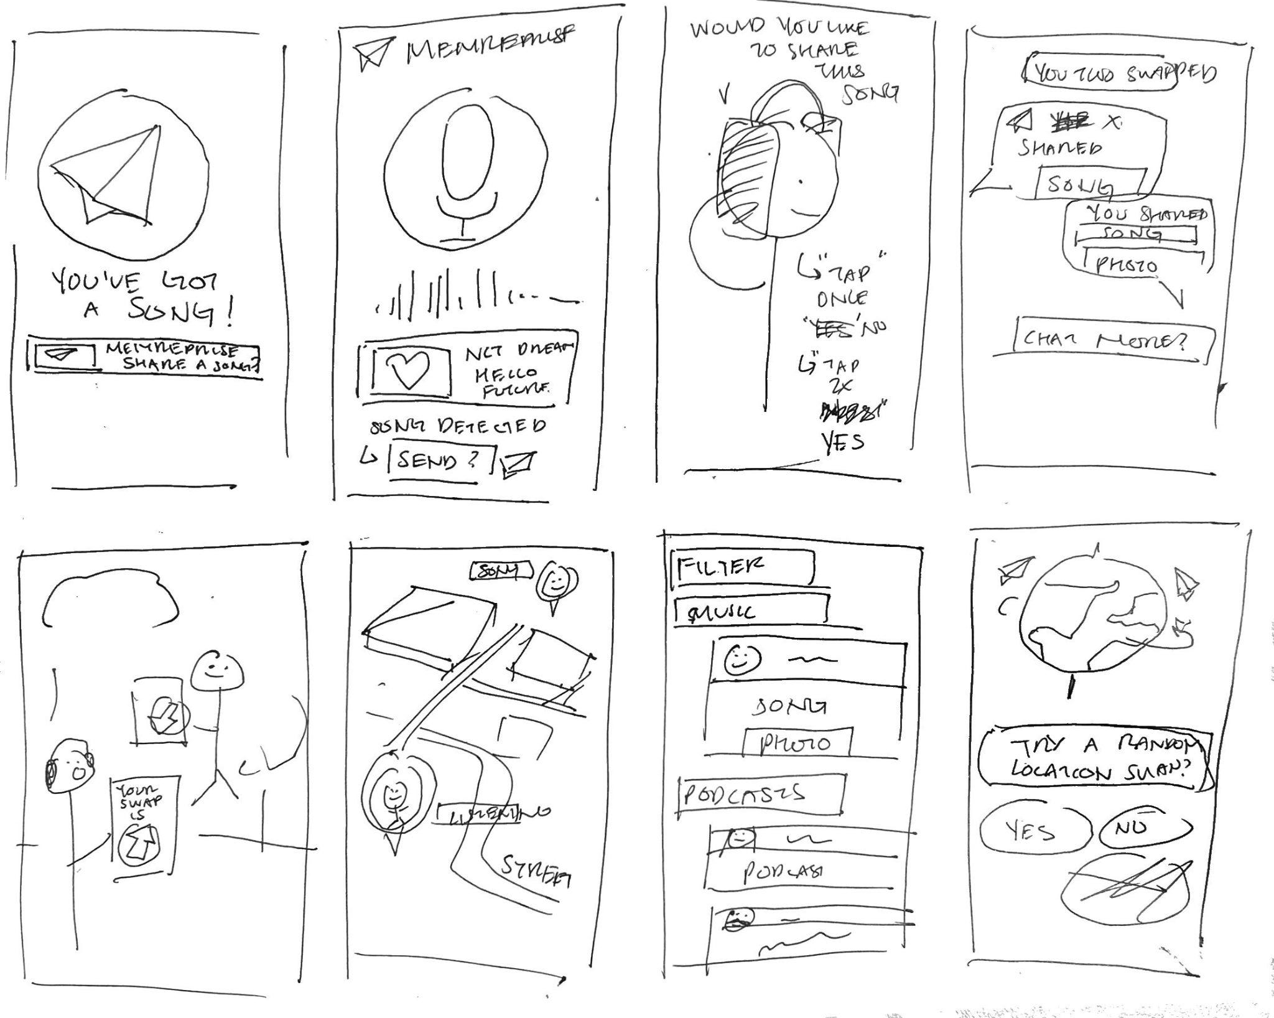
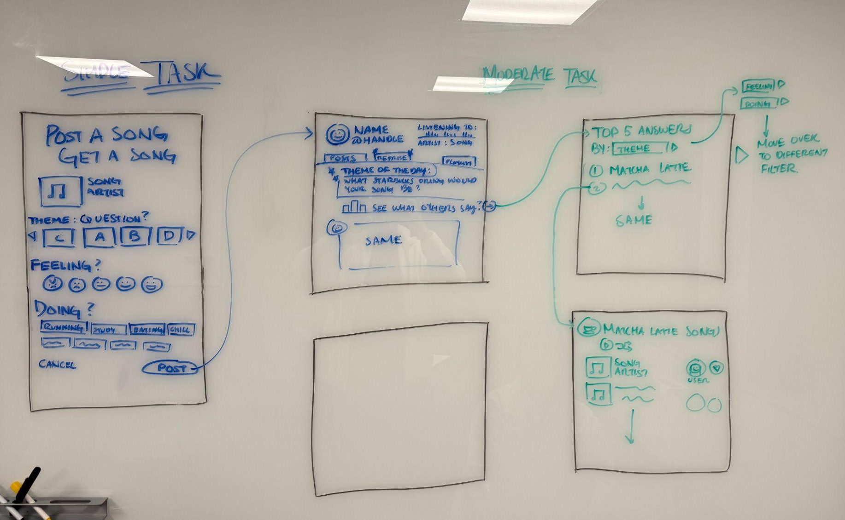
Crazy 8’s and Storyboards
Notes:
Summary of the results

Slide 11
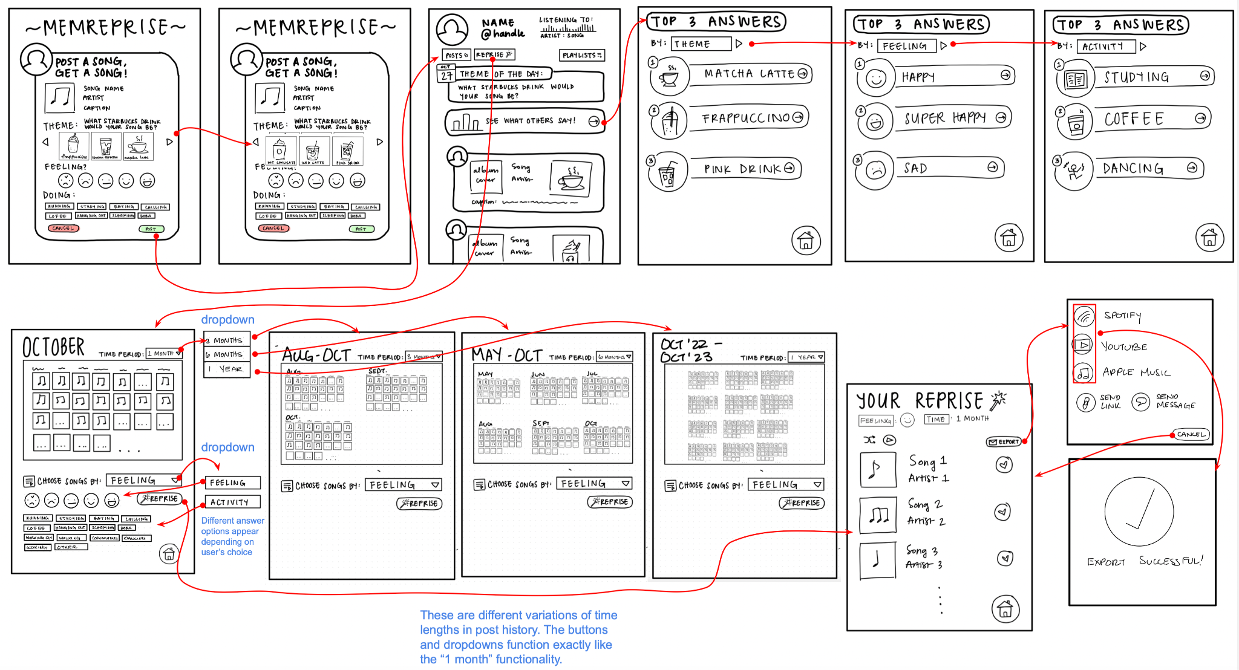
Lo-fi Prototype
Notes:
Additional details on severity 3-4 violations

Slide 12
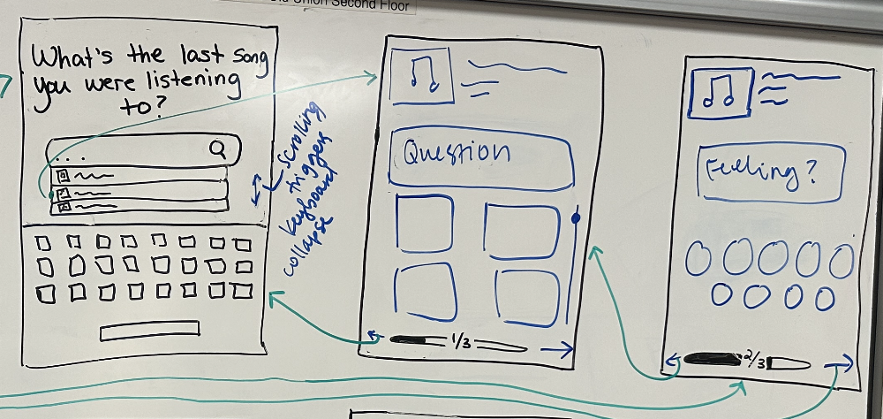
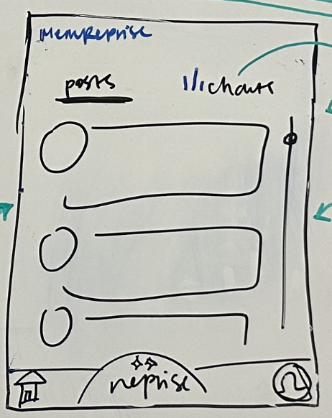
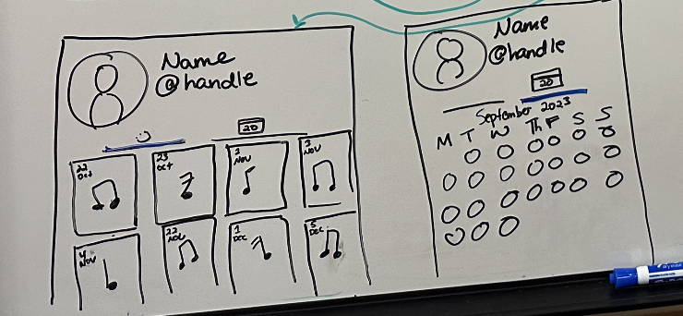
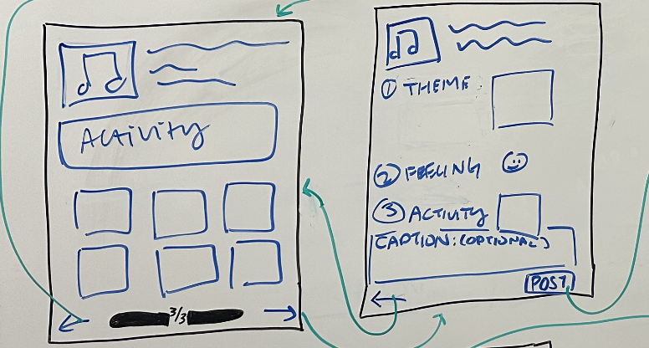
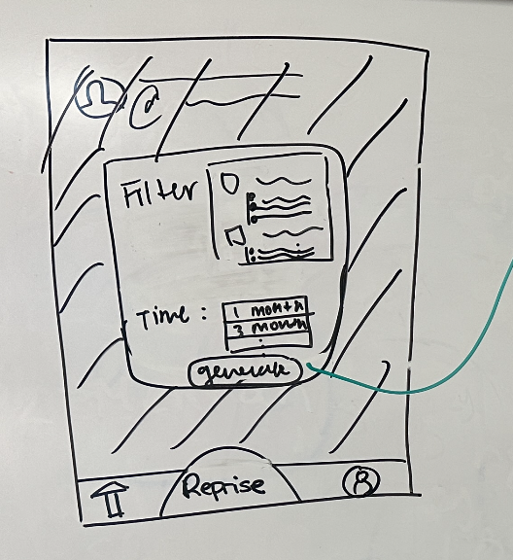
Lo-fi Changes
Information partitioned into separate screens and information grouped to enhance clarity and avoid cognitively overwhelming users
Post draft separated into multiple screens
Different tabs for different feeds
Clearer calendar access, separated post history and reprise
Notes:
Separating calendar and reprise
Users were confused about where to find their own posts —> created a personal calendar in user profile
Reprise is its own button, separate from the calendars, and will automatically lead users to filtering options for their reprise playlists

Slide 13
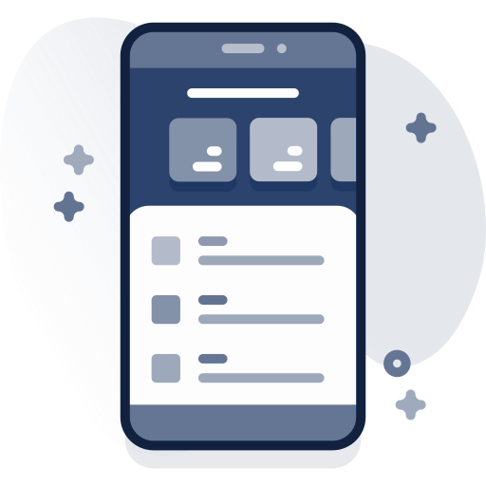


Med-fi Prototype
Visual Design (Aesthetics, Accessibility, and Consistency)
Usable and legible, interactive elements and text
Standardize size, labeling, and layout – information hierarchy
More Power to the User (Control, Flexibility, and Visibility)
Add features for greater user control over posting (privacy, deletion, incorporating play history)
Highlight existing areas of user control
Terminology
Rename and re-label features to reduce confusion
Create documentation for MemReprise specific terms and features
Notes:
Summary of the results

Slide 14
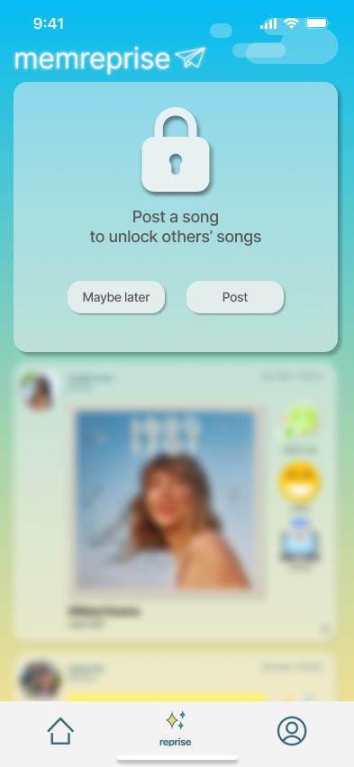
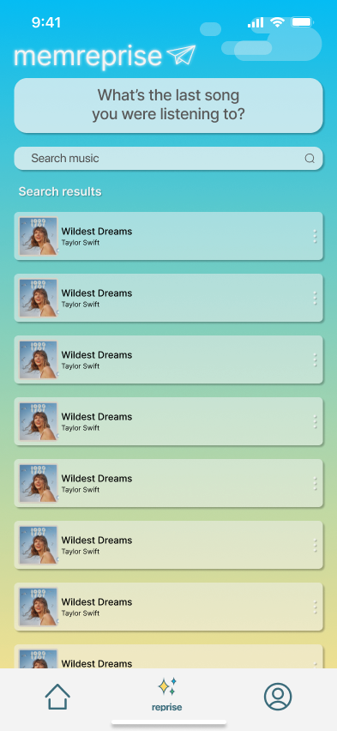
Search Up Song
Notes:
Additional details on severity 3-4 violations

Slide 15
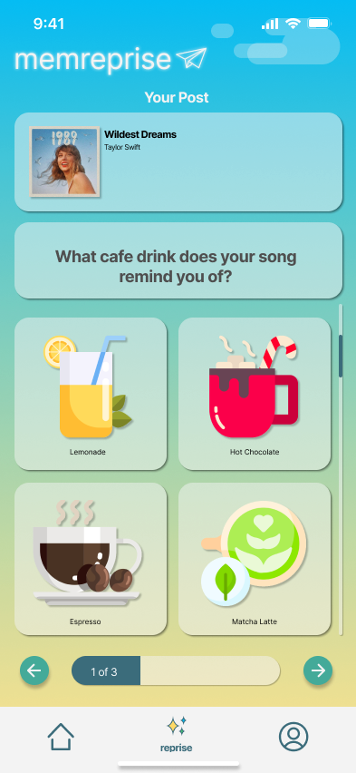
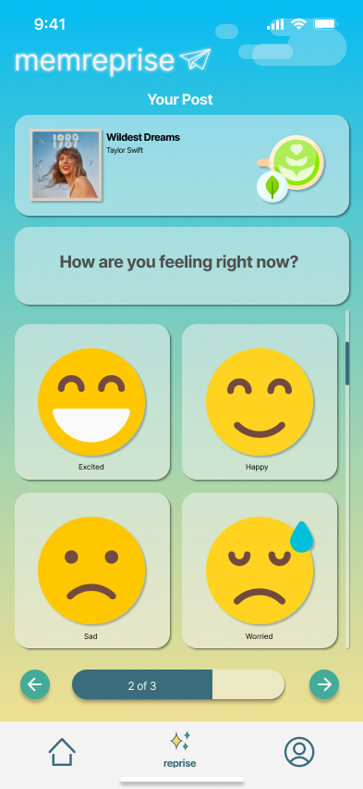
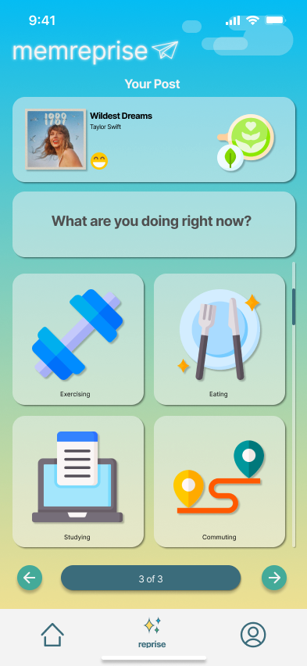
Personalize Post
Notes:
Additional details on severity 3-4 violations

Slide 16
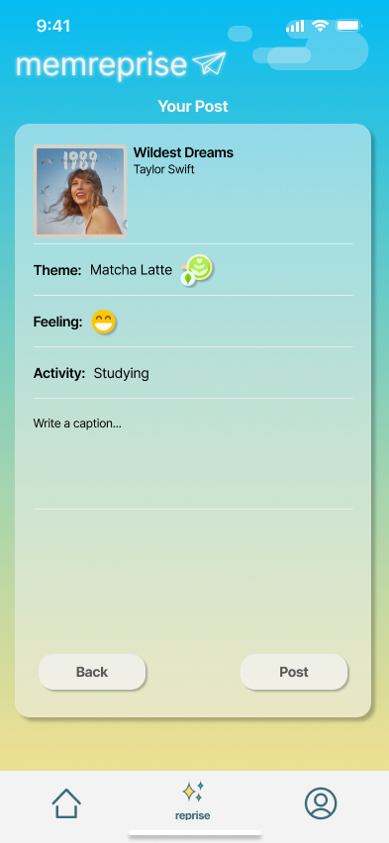
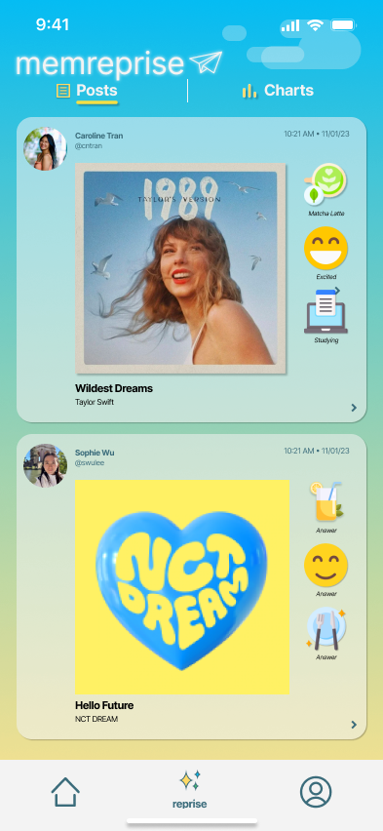
Finalize Post
Notes:
Additional details on severity 3-4 violations

Slide 17
Prototypes
Severity
Description
Fix
3
Users can’t view any content without posting
Allow users to view old posts without posting
3
There’s no indication of privacy level and audience when posting
Add privacy setting menu in the post preview
3
No explanation for making post
Create onboarding screens
Notes:
Additional details on severity 3-4 violations

Slide 18
Moderate Task
Discover music from other users with similar associations
Severity
Description
Fix
3
Unclear that “Charts” tab was where to go to discover music
Rename tab to “Discover”, and add labels to clarify
3
Text sizes across this task flow are very small
Increase and standardize text, sizes, & post layout
3
Controls and interactive elements are very small
Increase & standardize size of interactive elements
Notes:
Additional details on severity 3-4 violations

Slide 19
Complex Task
Create personalized playlist from songs you posted shared
Severity
Description
Fix
3
The term “Reprise” is unfamiliar to users
Explain term, functionality in onboarding screens
3
Calendar view of a user’s activity is organized in an confusing way
Add date labels & white space separation to better reflect chronological layout
3
Users cannot delete posts
Create onboarding screens
Notes:
Additional details on severity 3-4 violations

Slide 20
02
Current UI

Slide 21
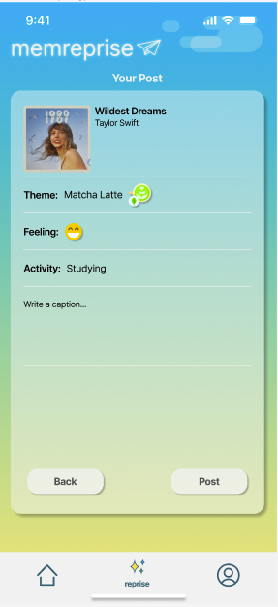
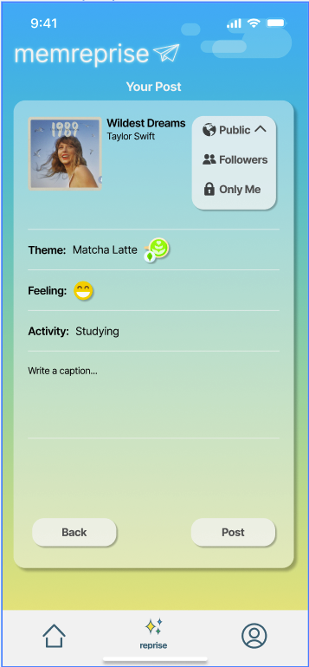
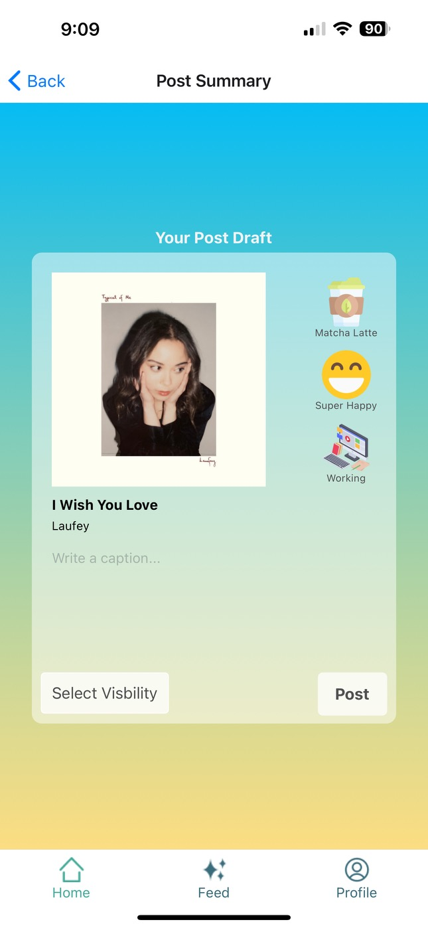
Post Overview
Before
After
Rationale:
User may not want to share post to everyone
Provides a memory archive for each user
Design is more legible
Progress towards usability goals:
Power to the user
Authentic posts
Personalized community
Notes:
Before and after shots + rationale

Slide 22
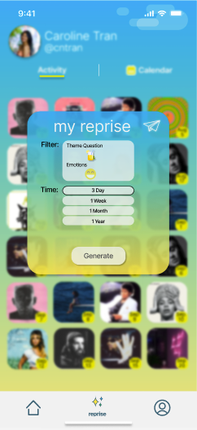

My Reprise Pop-Up
Before
After
Rationale:
Theme didn’t have a clear meaning
Filtering didn’t contain all options seen previously
Progress towards usability goals:
Gives user more autonomy on what to select
Specific between activity or emotions
Notes:
Before and after shots + rationale

Slide 23
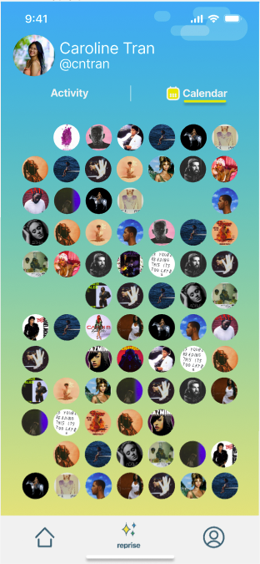
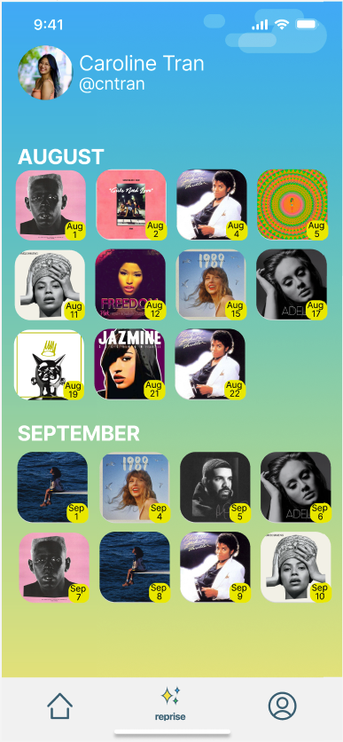
Calendar Activity
Before
After
Rationale:
Circles under calendar were too small and difficult to see
Circle icons not having dates were confusing
Progress towards usability goals:
Easier to see and click on
Clear what month these posts occurred on
Notes:
Before and after shots + rationale

Slide 24
New Screens Implemented
Notes:
Before and after shots + rationale

Slide 25
Representative Tasks
Notes:
Before and after shots + rationale

Slide 26
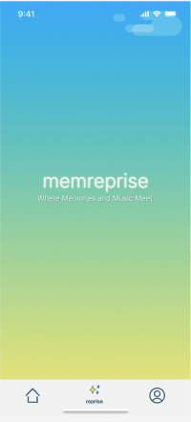
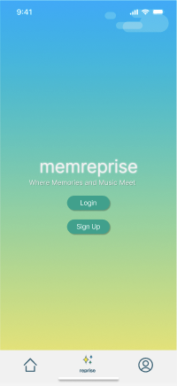
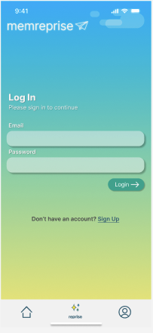
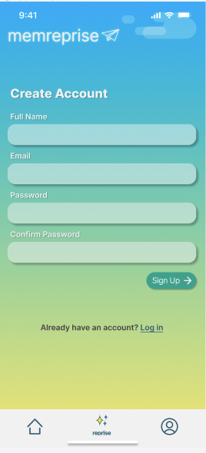
Task 0: Log In and Sign Up
Rationale:
New users can be identified and led through tutorial
Progress towards usability goals:
Once a user signs in, their information will be saved
Allows for user Spotify music to easily be accessible
Smaller learning curve
Notes:
Before and after shots + rationale

Slide 27
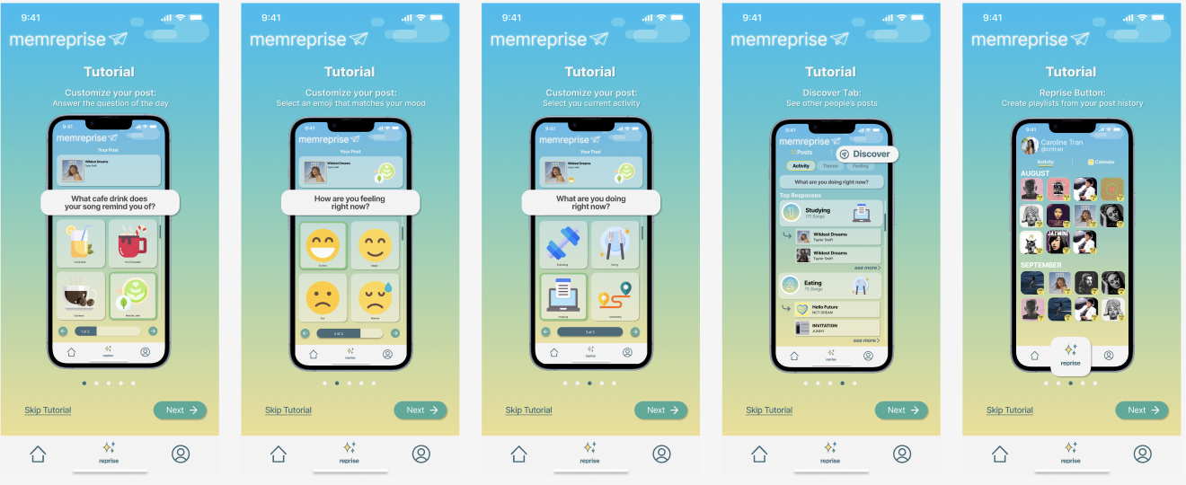
Tutorial
Rationale:
Users can could be potentially confused on how to work the app
Step-to-step guide to help with this
Progress towards usability goals:
Helps users understand the app before jumping straight in
Notes:
Before and after shots + rationale

Slide 28
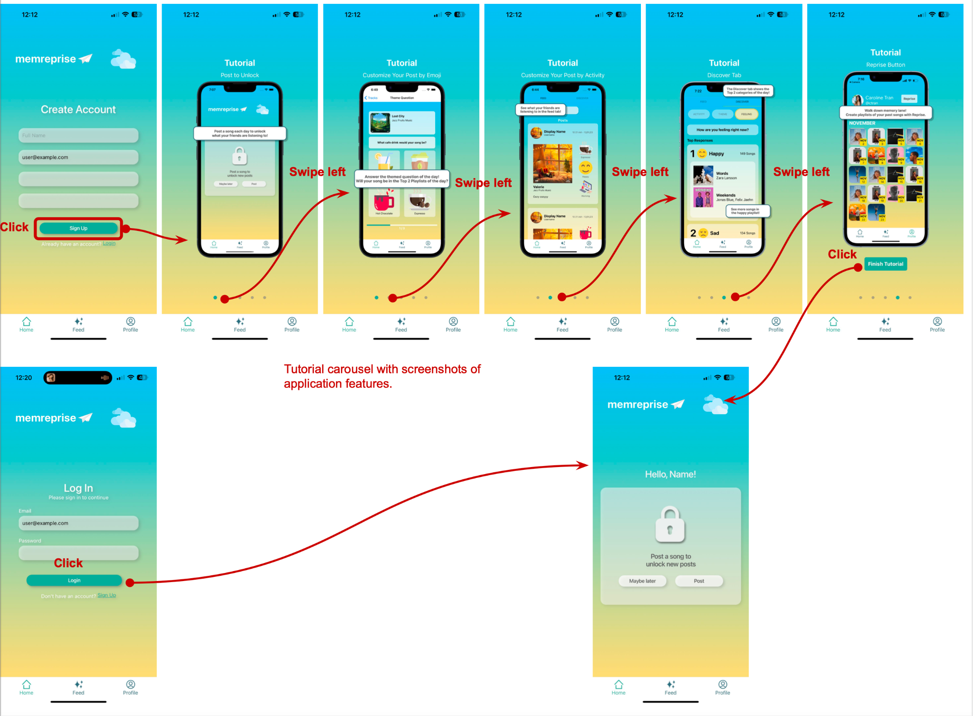
Task 0: Log In and Sign Up (with Tutorial)
Users can log in, or create an account if they don’t have one yet.
First-time users are presented with a tutorial, which they must complete before making their first post.
This enables users to learn the basics of the app and maintain a personal profile.
Notes:
Before and after shots + rationale

Slide 29
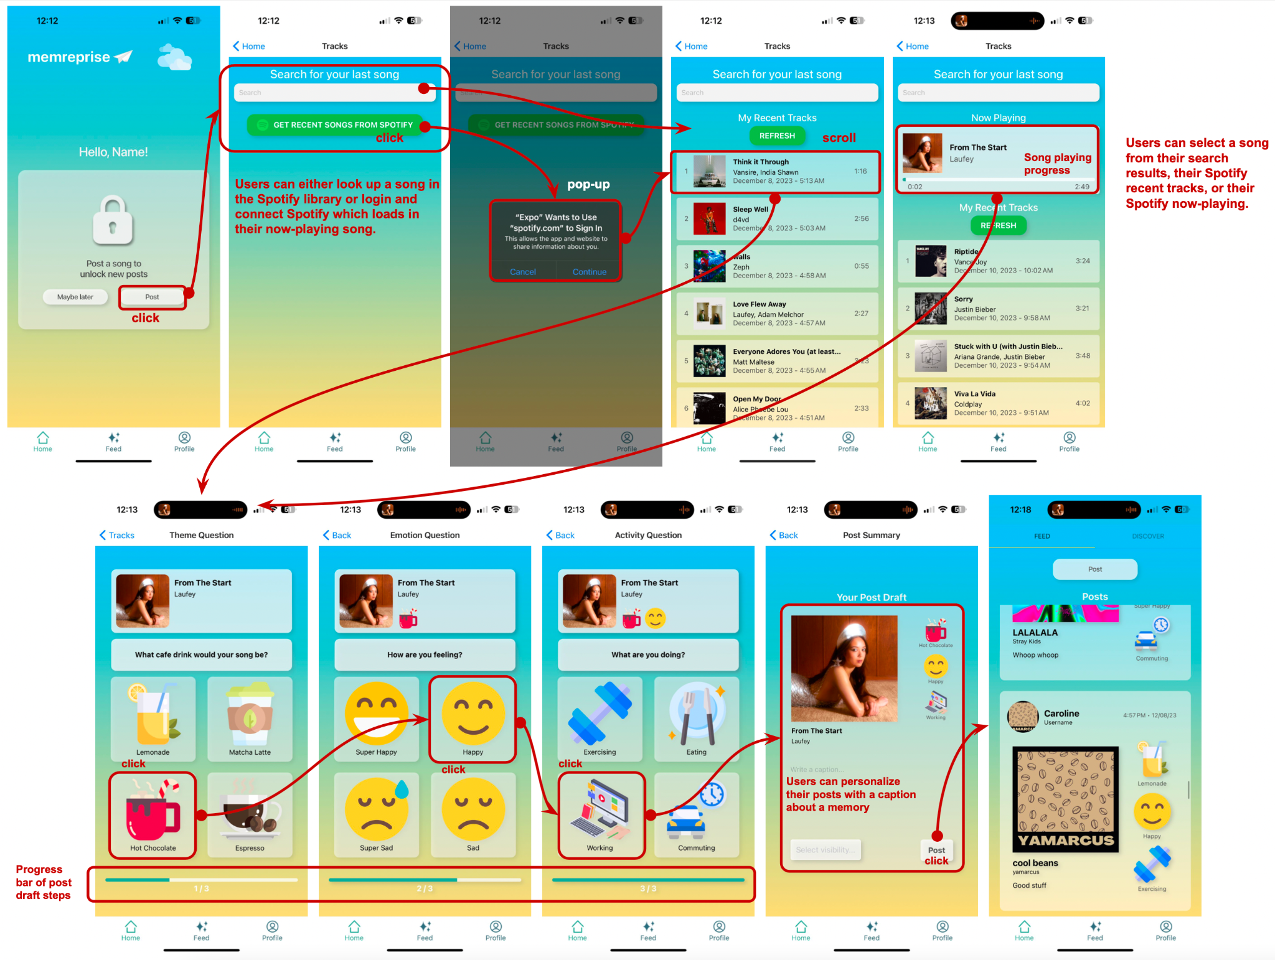
Task 1: Share a Song
Users post songs they listened to by searching for them or linking to Spotify.
They personalize their posts by answering simple prompts and adding a caption.
This enables users to record small moments of everyday music-listening, unlock songs that other users post, and feed their curiosity.
Notes:
Before and after shots + rationale

Slide 30
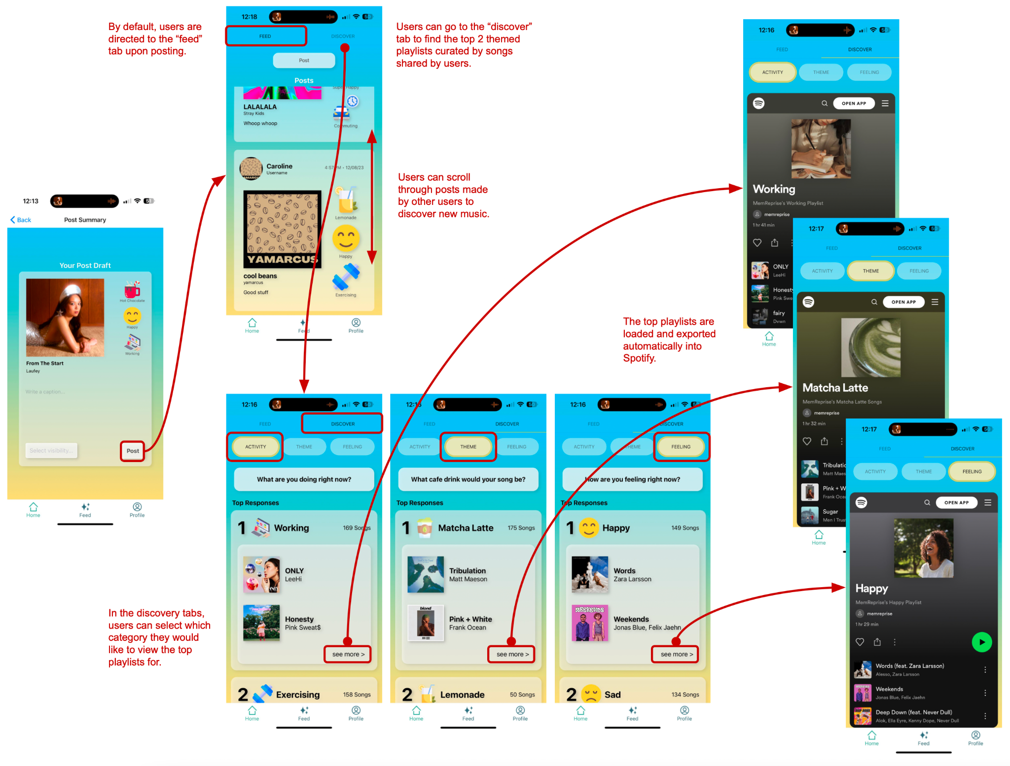
Task 2: Discover Music from Other Users with Similar Associations
After posting, users can discover new songs posted by others based on similar associations by exploring their feed, or the discovery tab with themed playlists.
This enables users to see music others have posted based on activity, theme, and feeling. Users can also discover new music based on categories that interest them.
Notes:
Before and after shots + rationale

Slide 31
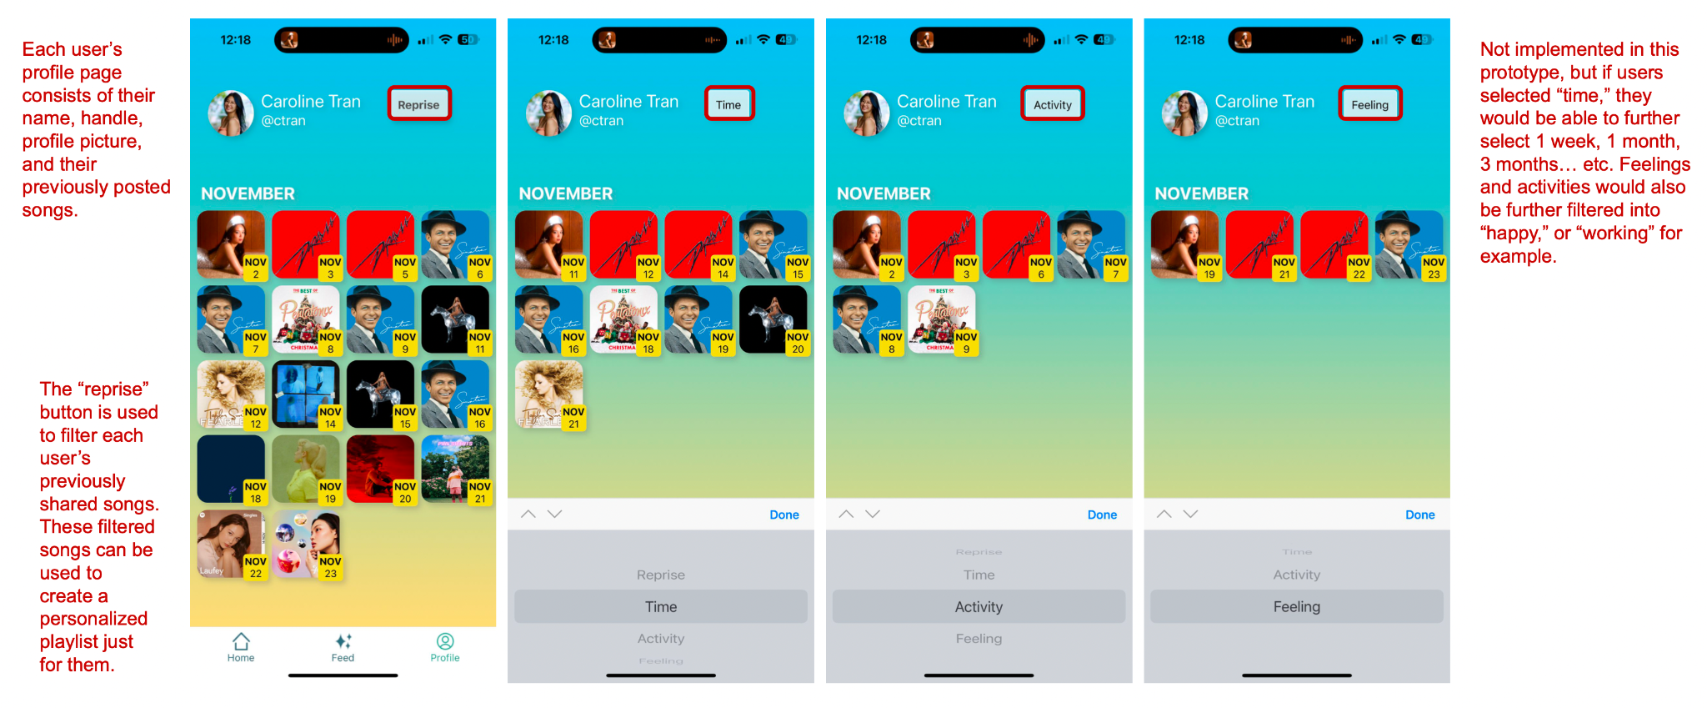
Task 3: Create Personalized Playlist from Previously Shared Songs
Using the profile tab, users can view the “reprise” of all the music they have posted. They can filter by time, activity, or feeling.
This enables users to access songs they have previously posted and filter them based on different categories.
Notes:
Before and after shots + rationale

Slide 32
03
Demo

Slide 33
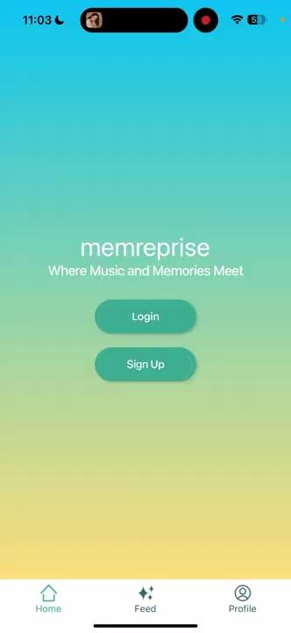
Notes:
Screen recording of the demo → talk over the recording live or have audio in the recording as well

Slide 34




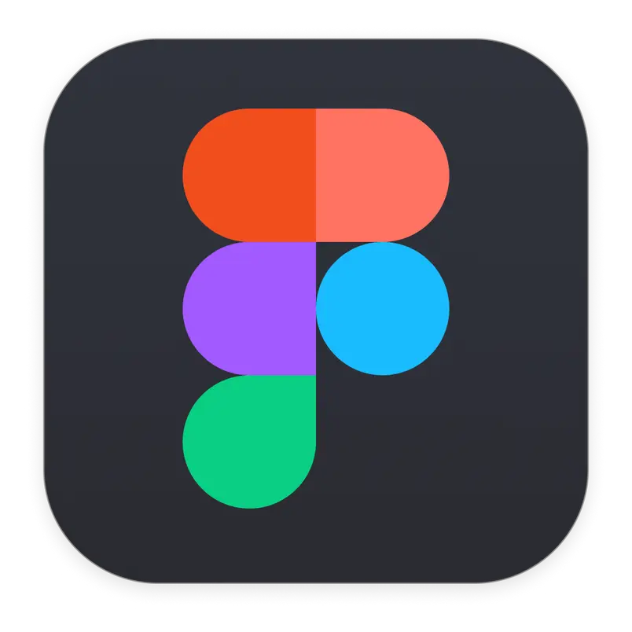
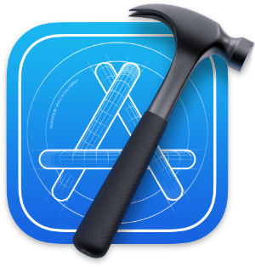



Framework & Tools Used
Framework
Tools Used
React Native
Expo Go
Figma
XCode
GitHub
VSCode: Prettier Extension
Spotify Developer API
Notes:
Framework: React Native and Expo
Tools Used:
Figma
VSCode
Prettier extension
Xcode for the simulator
Spotify Developer API
github

Slide 35
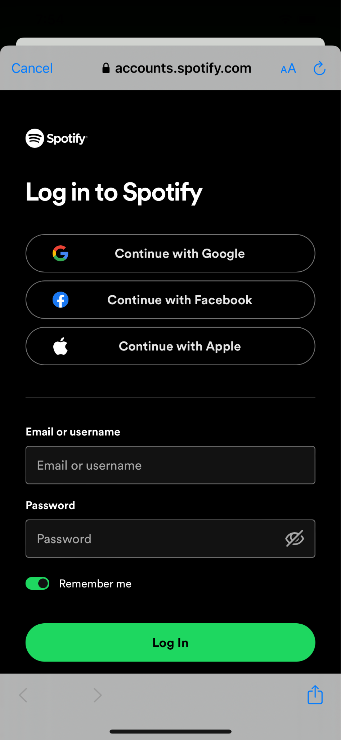
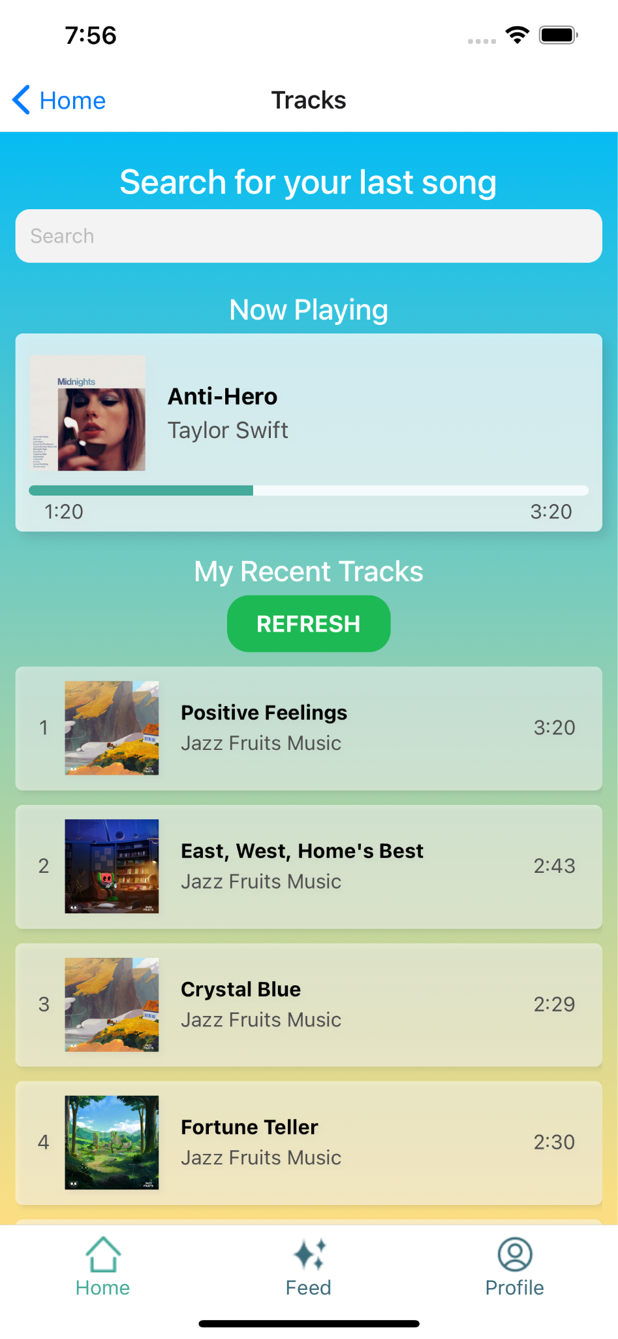
Implemented Features
Spotify API
Live Song Retrieval
Current Song Progress
All songs from Spotify Library can be searched for in the app
Pulls user’s now playing song so user does not have to search
Communicates status of system and shows current song playing
Notes:
Connect to spotify + song look up from spotify api
Retrieve recent songs and refresh recent songs
If user is currently listening to music, will display and have song progress goin

Slide 36
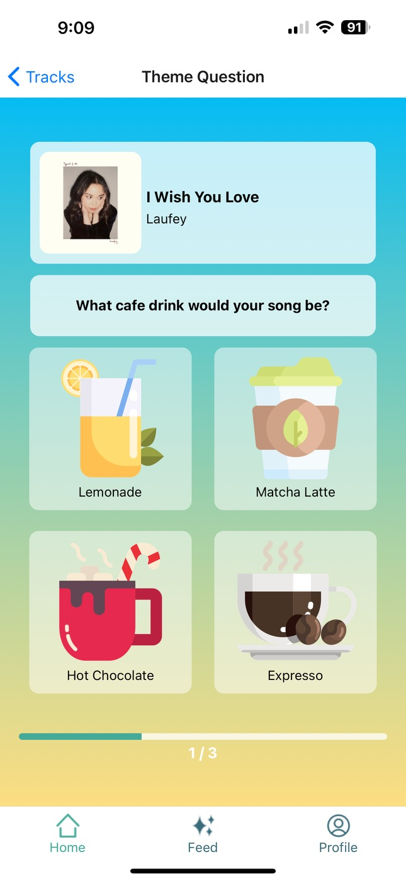
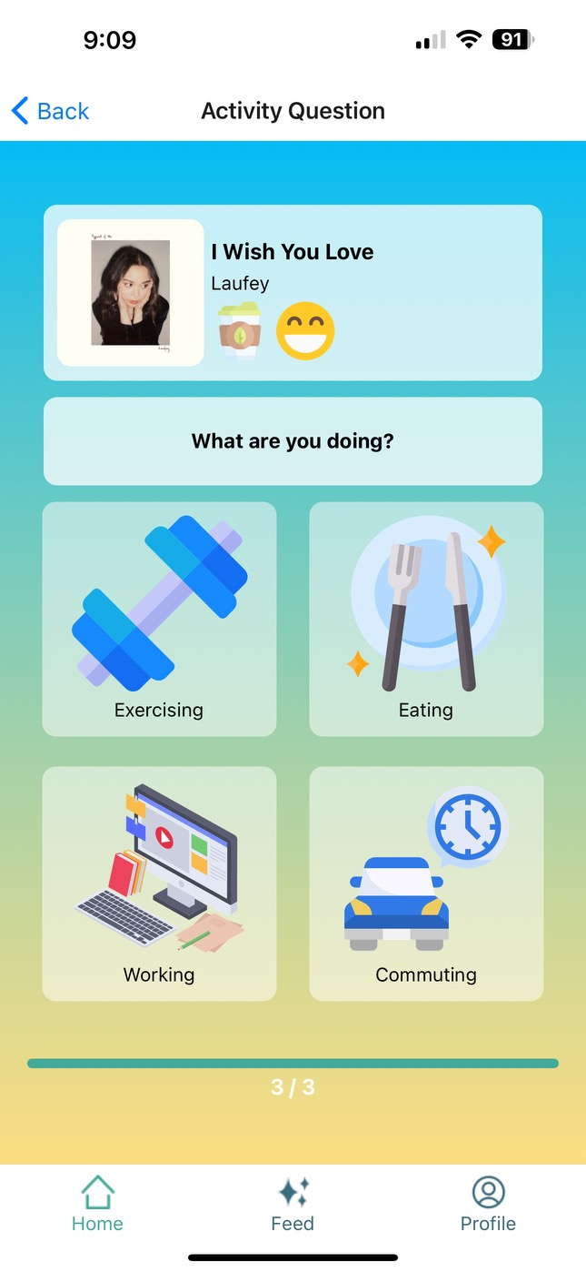

Implemented Features
Questionnaire
Progress Bar
Posts + Visibility
Users can select different options related to their song
Indicates how many more questions the user has to answer
Users can now write a caption with their post and select visibility
Notes:
Connect to spotify + song look up from spotify api
Retrieve recent songs and refresh recent songs
If user is currently listening to music, will display and have song progress goin

Slide 37
Missing Features + Hard Coded Aspects
Log-in credentials not stored in database
Top 3 playlists and results for each category generated from static data
Post visibility: visibility status is static, not stored in database
Month headers in profile are static
Notes:
Feed: User posts
Other user data → supabase
Top 3 playlists and results for each category
User calendar with past posts collage

Slide 38
Issues or Questions
Q1
Q2
Q3
How to address non-spotify users?
Is it possible to have multiple/randomized theme questions of the day?
Should we prioritize popularity or how recent a post is?
Notes:
Anything we are still unsure about and would like feedback on
How to address non-spotify users?
Getting around Spotify authentication
Is it feasible to have multiple/randomized theme questions of the day
How to show information people want to see → tags
Feed: should we prioritize popularity or how recent a post is? → this is static

Slide 39
04
Future Enhancements

Slide 40
Potential Additions and Changes
Include more tagging options and categories for posts (perhaps include a scrollable list for emojis): grants users more freedom of expression.
Group similar selections together for playlists (perhaps using LLMs): more convenient for the user when creating playlists.
Dark mode, accessibility features, etc.: improves usability.
Notes:
Feed: User posts
Other user data → supabase
Top 3 playlists and results for each category
User calendar with past posts collage

Slide 41
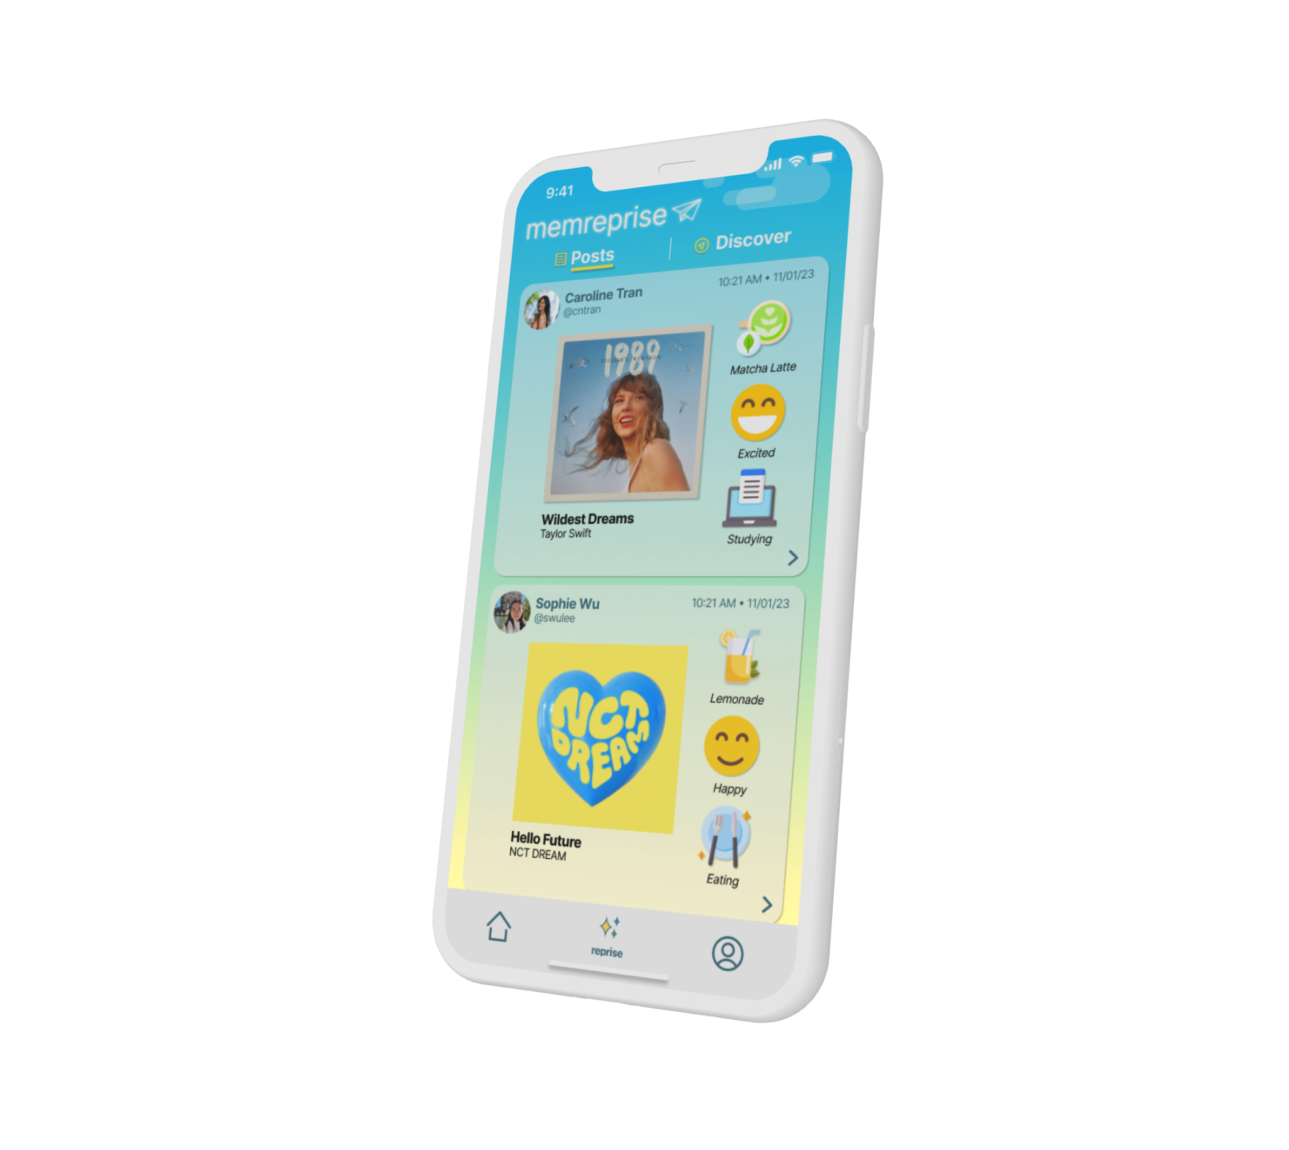
Thanks
Do you have any questions?
memreprise
where music and memories meet

Slide 42
COLOR SCHEME FOR SLIDES
#ffd966
#fce08c
#fff3ce
#1c2e50
#9ecaec
#44aa99
#a2cec6

